Slide 1
Entity-Relationship Model
Modified by
Shadman Rabby
Lecturer, Dept. of CSE, Daffodil Internatioal University
Created by
Professor Dr. K. M. Azharul Hasan
Dept. of CSE, KUET

Slide 2
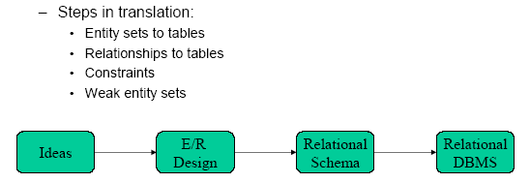
Entity-Relationship Model
An entity relationship diagram (ERD) is a representation of data within a domain. It consists of entities as well as relationships between entities.
A graphical representation of entities and their relationships to each other
A logical data model of the real world.

Slide 3
Modeling
A database can be modeled as:
a collection of entities,
relationship among entities.
An entity is an object that exists and is distinguishable from other objects.
Example: specific person, company, event, plant
Entities have attributes
Example: people have names and addresses
An entity set is a set of entities of the same type that share the same properties.
Example: set of all persons, companies, trees, holidays

Slide 4
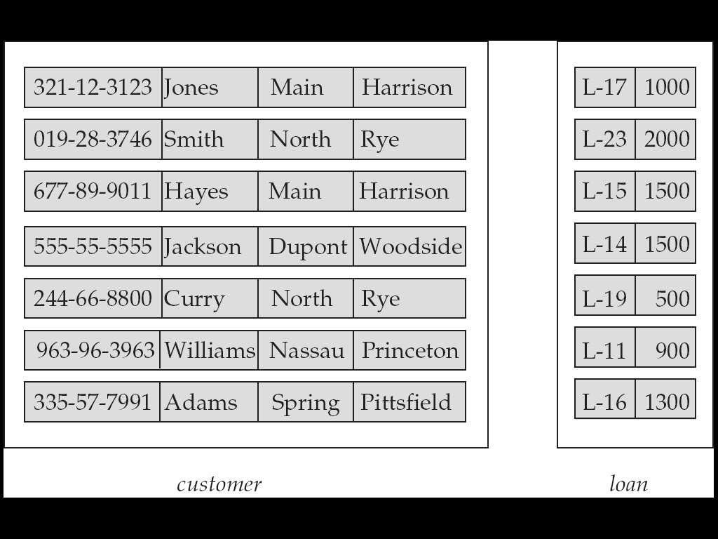
Entity Sets customer and loan
customer_id customer_ customer_ customer_ loan_ amount name street city number

Slide 5
Attributes
An entity is represented by a set of attributes, that is descriptive properties possessed by all members of an entity set.
Domain – the set of permitted values for each attribute
Example: customer = (customer_id, customer_name, customer_street, customer_city ) loan = (loan_number, amount )

Slide 6
Attribute types:
Simple attributes: Student_Id
composite attributes : Street (street can be further devided into street no, street_name etc.
Single-valued and multi-valued attributes
Example: multi valued attribute: phone_numbers
Derived attributes
Can be computed from other attributes
Example: age, given date_of_birth

Slide 7
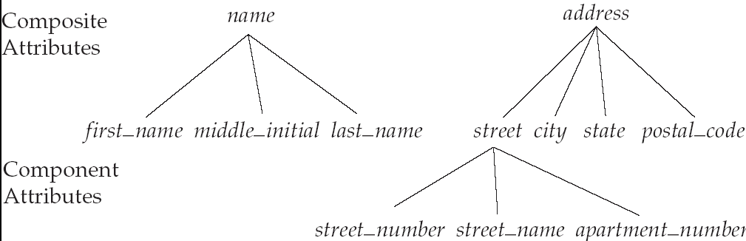
Composite Attributes

Slide 8
Relationship Sets
A relationship is an association among several entities
Example: Hayes depositor A-102 customer entity relationship set account entity
A relationship set is a mathematical relation among n ≥ 2 entities, each taken from entity sets
{(e₁, e₂, … e_{n}) | e₁ ∈ E₁, e₂ ∈ E₂, …, e_{n} ∈ E_{n}} where (e₁, e₂, …, e_{n}) is a relationship
Example:
(Hayes, A-102) ∈ depositor

Slide 9
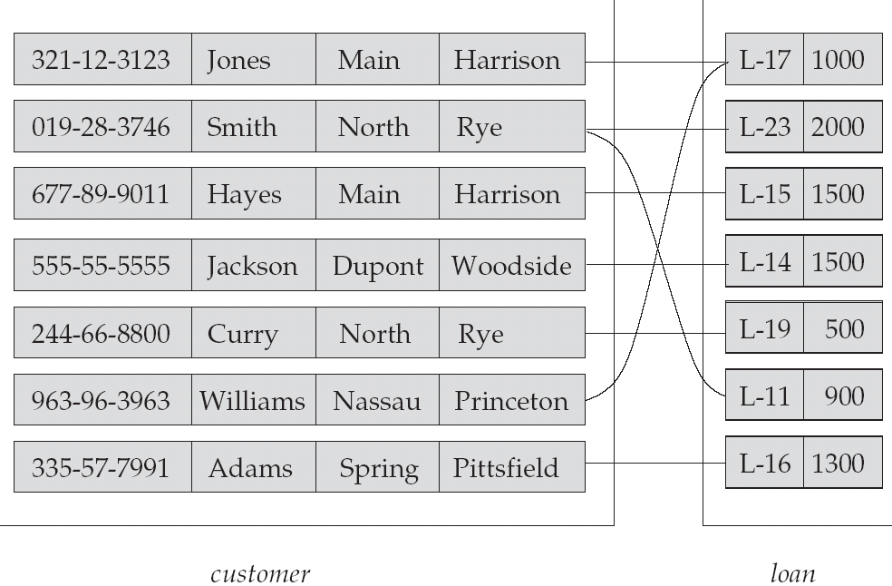
Relationship Set borrower

Slide 10
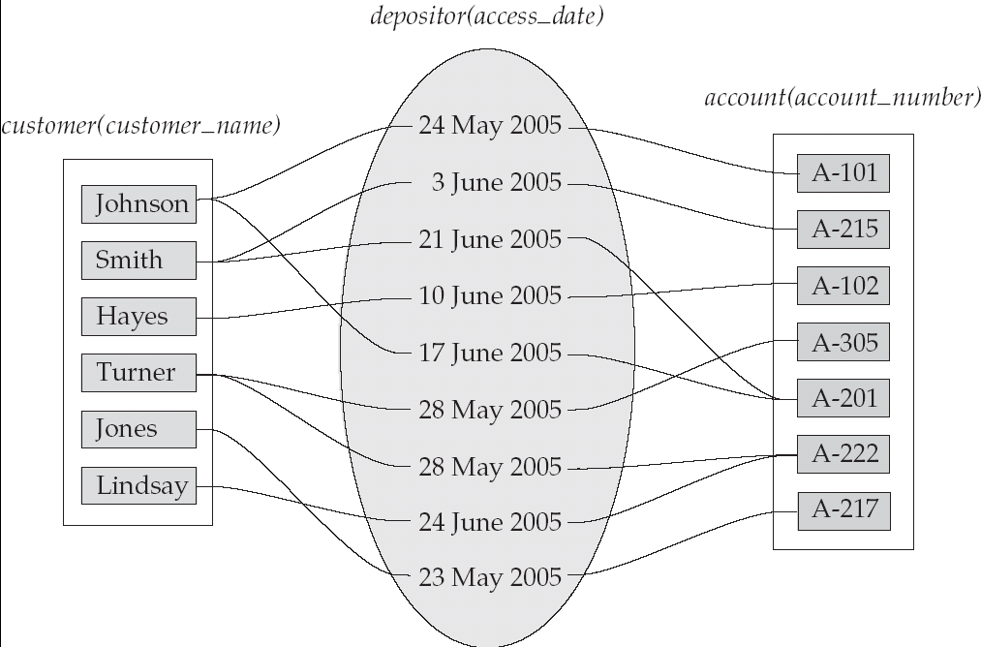
Relationship Sets (Cont.)
An attribute can also be property of a relationship set.
For instance, the depositor relationship set between entity sets customer and account may have the attribute access-date

Slide 11
Degree of a Relationship Set
Refers to number of entity sets that participate in a relationship set.
Relationship sets that involve two entity sets are binary (or degree two). Generally, most relationship sets in a database system are binary.
Relationships between more than two entity sets are rare. Most relationships are binary.

Slide 12
Mapping Cardinality Constraints
Number of entities to which another entity can be associated via a relationship set.
Most useful in describing binary relationship sets.
For a binary relationship set the mapping cardinality must be one of the following types:
One to one
One to many
Many to one
Many to many

Slide 13
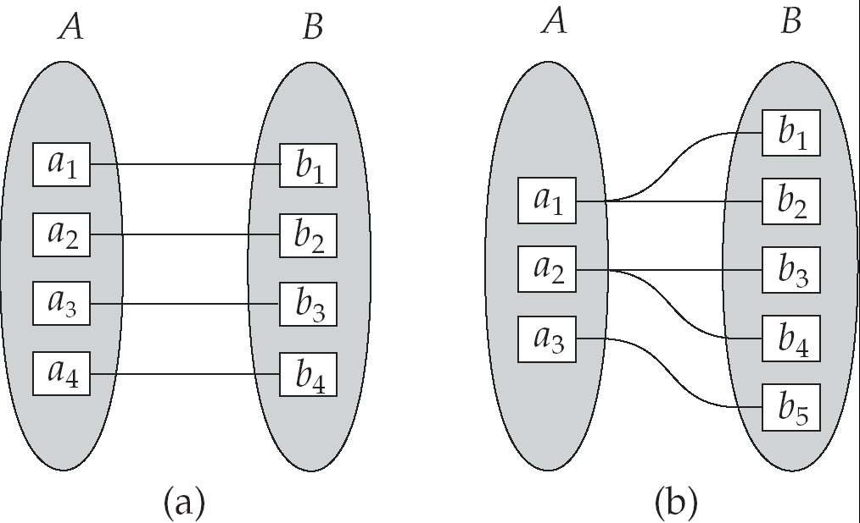
Mapping Cardinalities
One to one
One to many

Slide 14
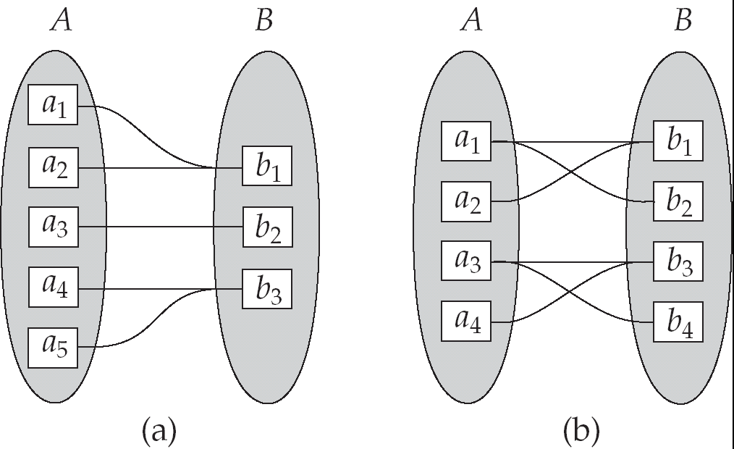
Mapping Cardinalities
Many to one
Many to many

Slide 15
Keys
A super key of an entity set is a set of one or more attributes whose values uniquely determine each entity.
A candidate key of an entity set is a minimal super key
Customer_id is candidate key of customer
account_number is candidate key of account
Although several candidate keys may exist, one of the candidate keys is selected to be the primary key.

Slide 16
Keys for Relationship Sets
The combination of primary keys of the participating entity sets form a super key of a relationship set.
(customer_id, account_number) is the super key of depositor
Must consider the mapping cardinality of the relationship set when deciding what are the candidate keys

Slide 17
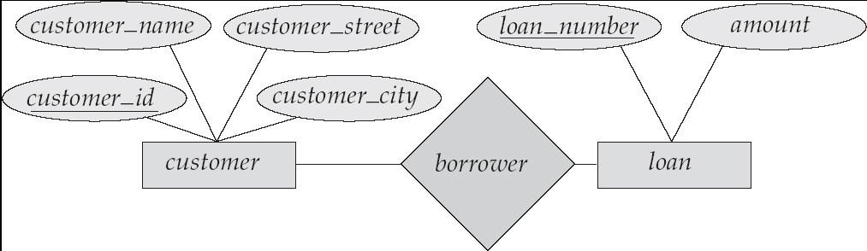
E-R Diagrams
Rectangles represent entity sets.
Diamonds represent relationship sets.
Lines link attributes to entity sets and entity sets to relationship sets.
Ellipses represent attributes
Double ellipses represent multivalued attributes.
Dashed ellipses denote derived attributes.
Underline indicates primary key attributes

Slide 18
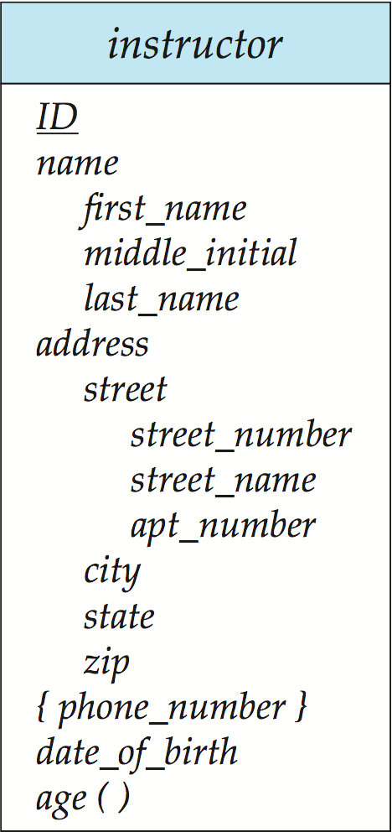
Entity With Composite, Multivalued, and Derived Attributes

Slide 19
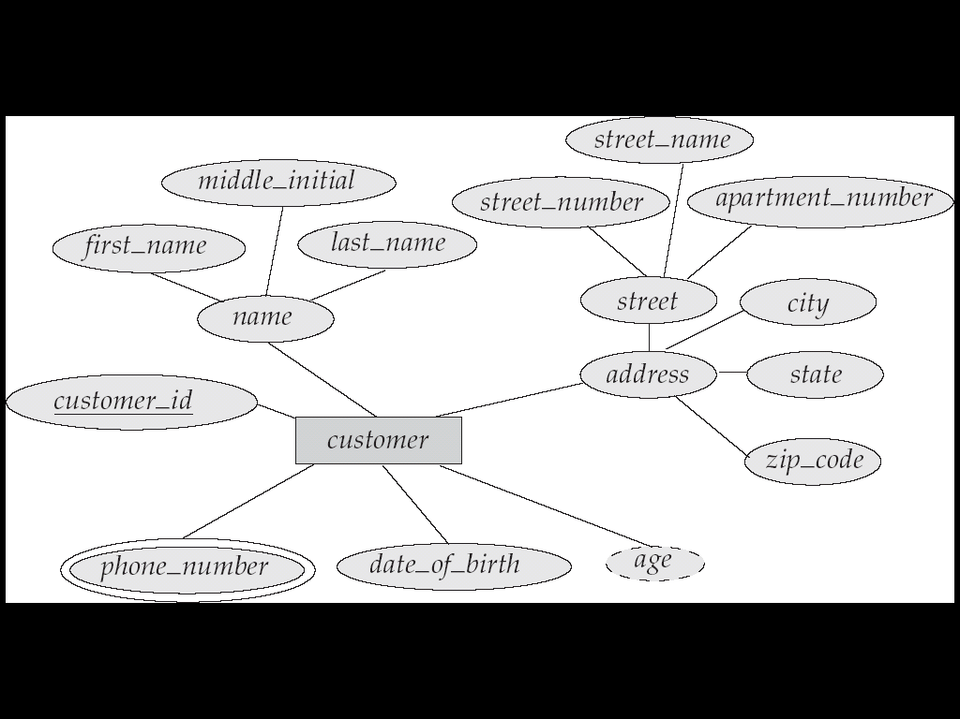
E-R Diagram With Composite, Multivalued, and Derived Attributes

Slide 20
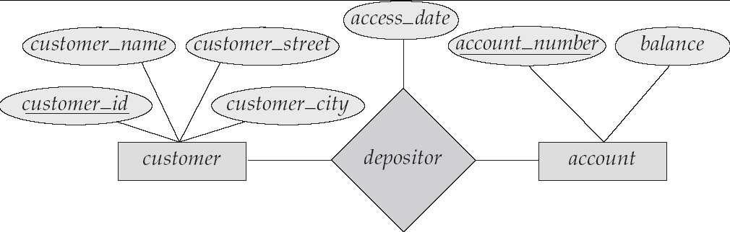
Relationship Sets with Attributes

Slide 21
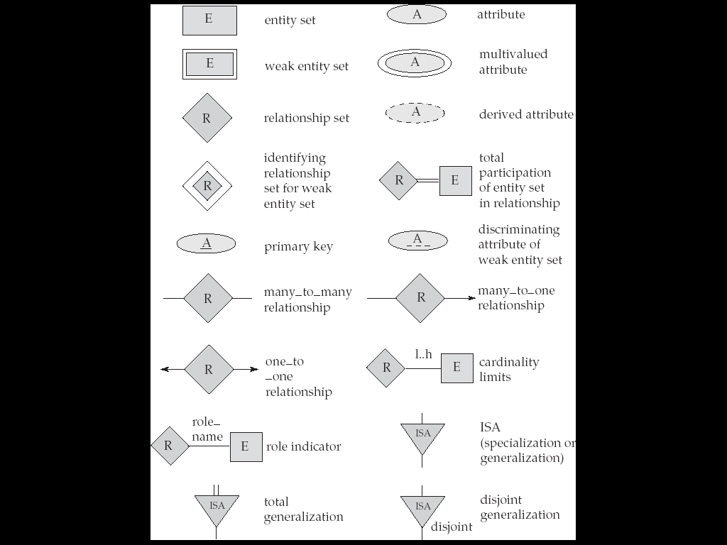
Summary of Symbols Used in E-R Notation

Slide 22
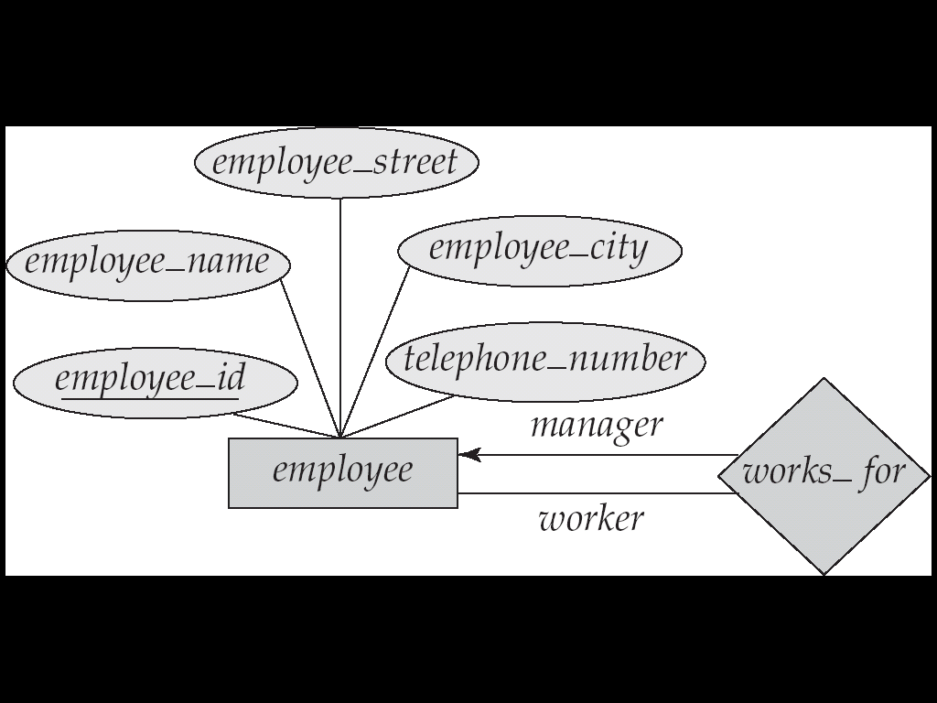
Roles
The function that an entity plays in a relationship is called role.
The labels “manager” and “worker” are called roles; they specify how employee entities interact via the works_for relationship set.
Roles are indicated in E-R diagrams by labeling the lines that connect diamonds to rectangles.
Role labels are optional, and are used to clarify semantics of the relationship

Slide 23
Cardinality Constraints
We express cardinality constraints by drawing either a directed line (→), signifying “one,” or an undirected line (—), signifying “many,” between the relationship set and the entity set.
One-to-one relationship:
A customer is associated with at most one loan via the relationship borrower
A loan is associated with at most one customer via borrower

Slide 24
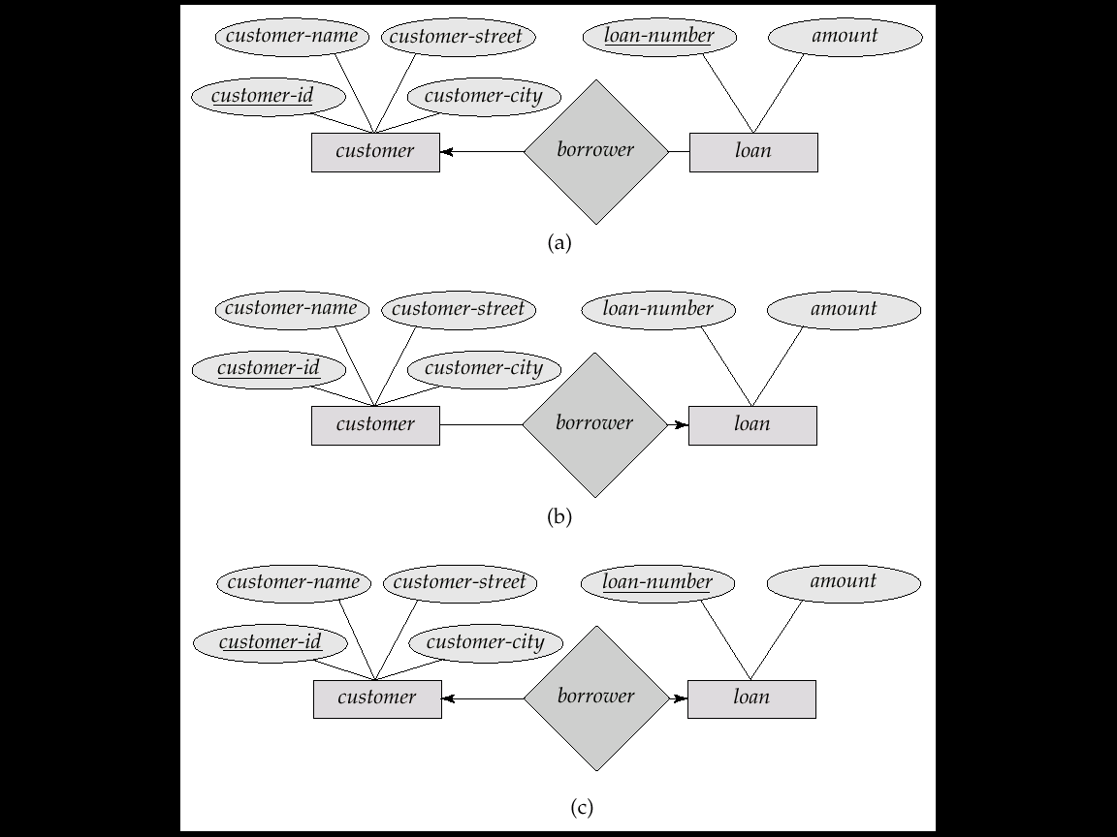
One-To-Many Relationship
In the one-to-many relationship a loan is associated with at most one customer via borrower, a customer is associated with several (including 0) loans via borrower

Slide 25
Many-To-One Relationships
In a many-to-one relationship a loan is associated with several (including 0) customers via borrower, a customer is associated with at most one loan via borrower

Slide 26
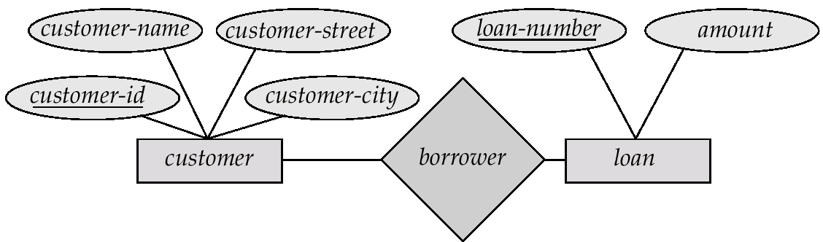
Many-To-Many Relationship
A customer is associated with several (possibly 0) loans via borrower
A loan is associated with several (possibly 0) customers via borrower

Slide 27
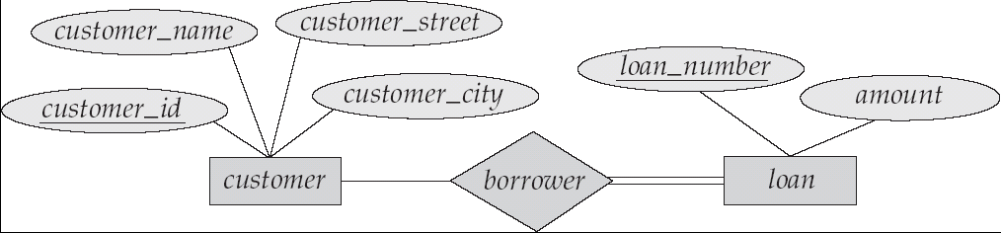
Participation of an Entity Set in a Relationship Set
Total participation (indicated by double line): every entity in the entity set participates in at least one relationship in the relationship set
E.g. participation of loan in borrower is total; every loan must have a customer
Partial participation: some entities may not participate in any relationship in the relationship set
Example: participation of customer in borrower is partial

Slide 28
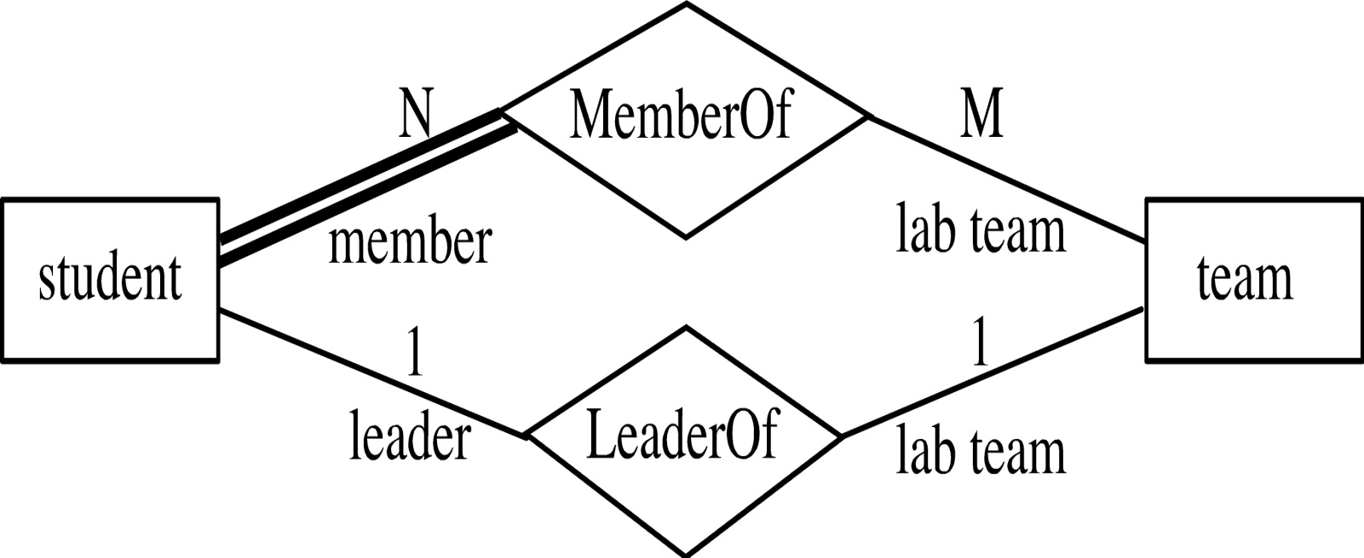
Participation of an Entity Set in a Relationship Set
Every student must be a member of a team
The participation of student in LeaderOf is partial, because only one student might be a team leader.

Slide 29
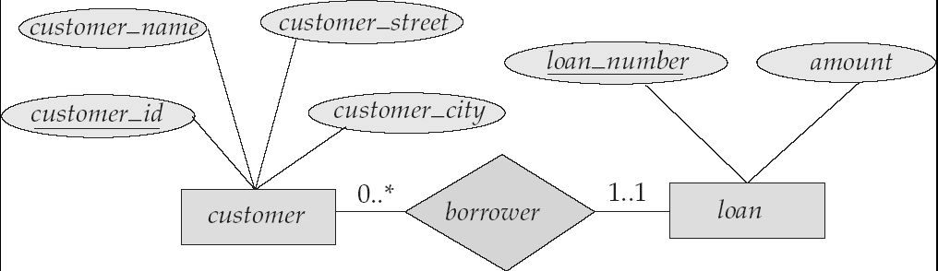
Alternative Notation for Cardinality Limits
Cardinality limits can also express participation constraints

Slide 30
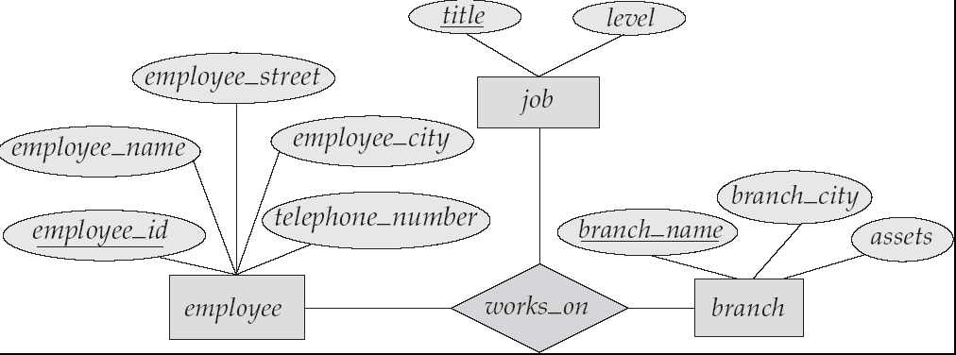
E-R Diagram with a Ternary Relationship

Slide 31
Weak Entity Sets
An entity set that does not have a primary key is referred to as a weak entity set.
The existence of a weak entity set depends on the existence of a identifying entity set
weak entity set relate to the identifying entity set via a total, one-to-many relationship
Identifying relationship depicted using a double diamond

Slide 32
Weak Entity Sets
The discriminator (or partial key) of a weak entity set is the set of attributes that distinguishes among all the entities of a weak entity set.
The primary key of a weak entity set is formed by the primary key of the strong entity set on which the weak entity set is existence dependent, plus the weak entity set’s discriminator.

Slide 33
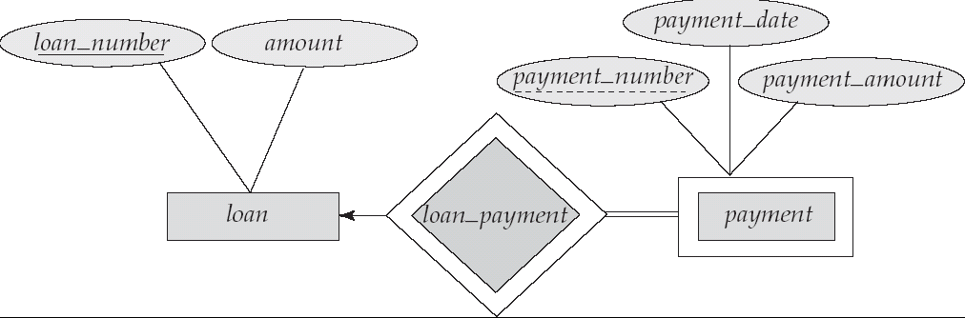
Weak Entity Sets (Cont.)
We depict a weak entity set by double rectangles.
We underline the discriminator of a weak entity set with a dashed line.
Primary key for payment – (loan_number, payment_number)

Slide 34
Extended E-R Features: Specialization
Top-down design process; we designate sub groupings within an entity set that are distinctive from other entities in the set.
Depicted by a triangle component labeled ISA (E.g. customer “is a” person).
Attribute inheritance – a lower-level entity set inherits all the attributes and relationship participation of the higher-level entity set to which it is linked.

Slide 35
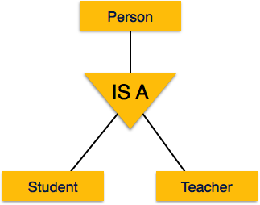
Specialization
A group of entities is divided into sub-groups based on their characteristics

Slide 36
Extended ER Features: Generalization
A bottom-up design process – combine a number of entity sets that share the same features into a higher-level entity set.
Specialization and generalization are simple inversions of each other; they are represented in an E-R diagram in the same way.
The terms specialization and generalization are used interchangeably.
The ISA relationship also referred to as superclass - subclass relationship

Slide 37
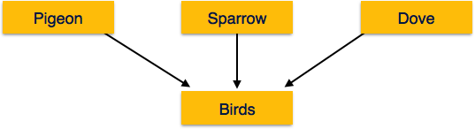
Generalization
Process of generalizing entities. The generalized entities contain the properties of all the generalized entities called generalization

Slide 38
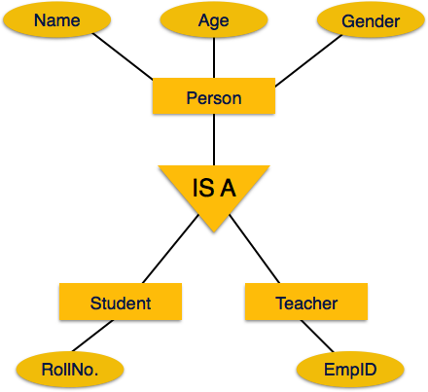
Specialization/Generalization Example

Slide 39
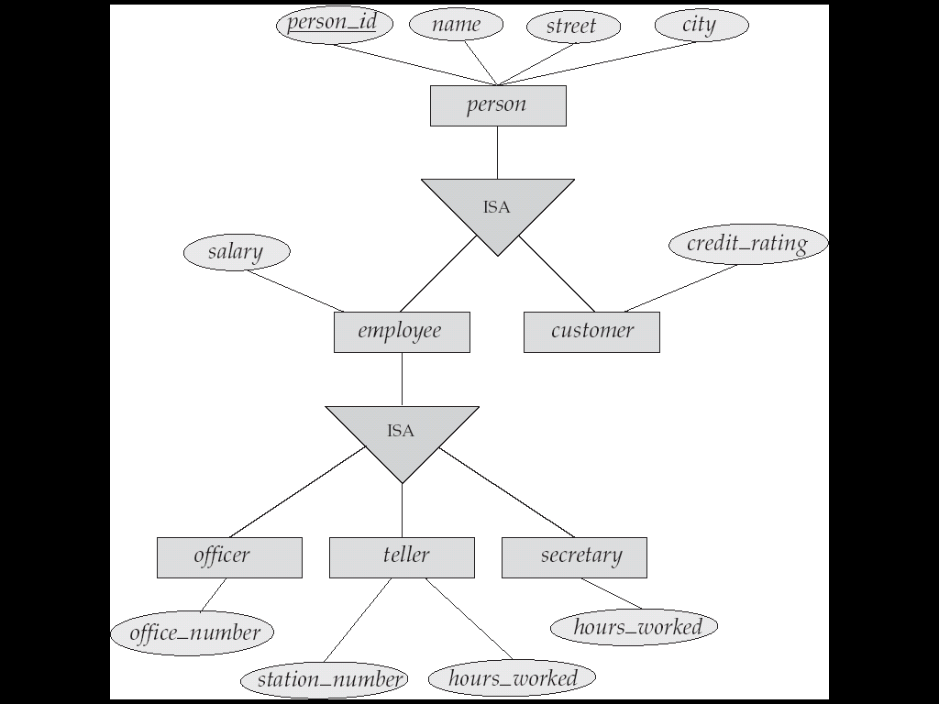
Specialization/Generalization Example

Slide 40
Design Constraints on a Specialization/Generalization
Constraint on which entities can be members of a given lower-level entity set.
condition-defined
Example: all customers over 65 years are members of senior-citizen entity set; senior-citizen ISA person.
user-defined
Constraint on whether or not entities may belong to more than one lower-level entity set within a single generalization.
Disjoint
an entity can belong to only one lower-level entity set
Noted in E-R diagram by writing disjoint next to the ISA triangle
Overlapping
an entity can belong to more than one lower-level entity set

Slide 41
Design Constraints on a Specialization/Generalization (Cont.)
Completeness constraint -- specifies whether or not an entity in the higher-level entity set must belong to at least one of the lower-level entity sets within a generalization.
total : an entity must belong to one of the lower-level entity sets
partial: an entity need not belong to one of the lower-level entity sets

Slide 42
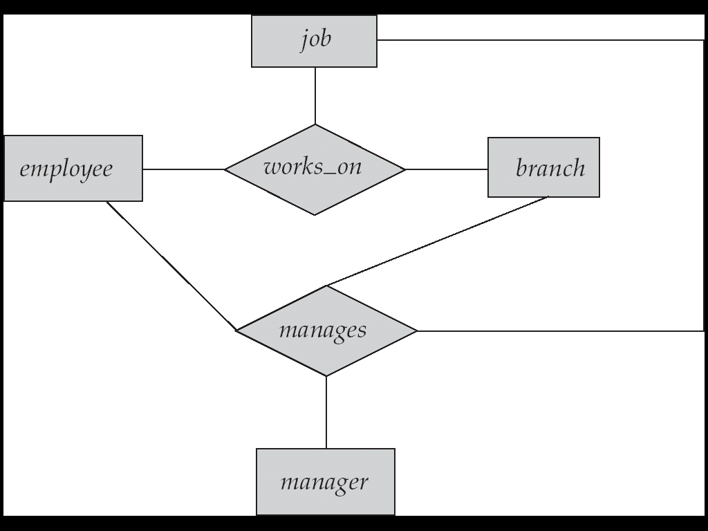
Aggregation
Suppose we want to record managers for tasks performed by an employee at a branch

Slide 43
Aggregation (Cont.)
Relationship sets works_on and manages represent overlapping information
Every manages relationship corresponds to a works_on relationship
However, some works_on relationships may not correspond to any manages relationships
So we can’t discard the works_on relationship
Eliminate this redundancy via aggregation
Treat relationship as an abstract entity
Allows relationships between relationships
Abstraction of relationship into new entity
Without introducing redundancy
An employee works on a particular job at a particular branch
An employee, branch, job combination may have an associated manager

Slide 44
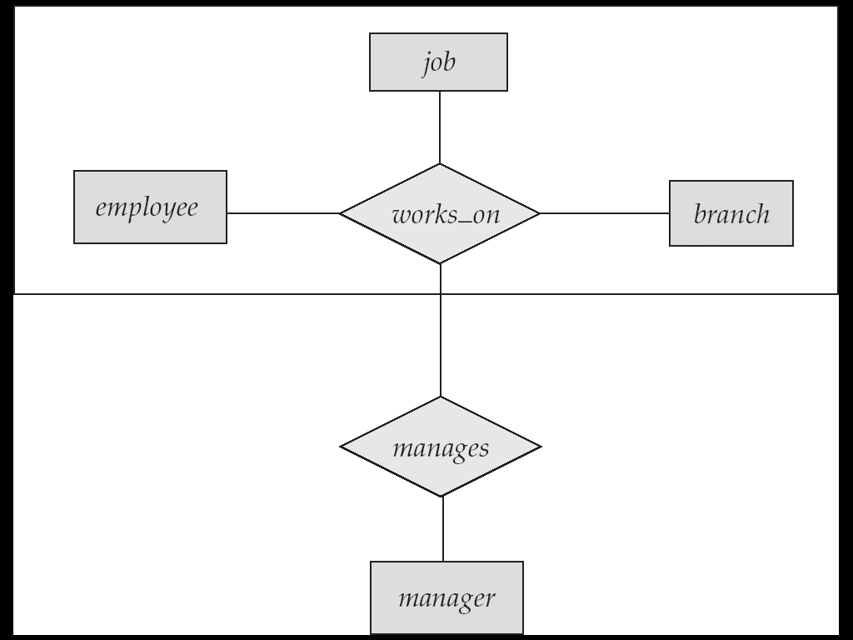
E-R Diagram With Aggregation

Slide 45
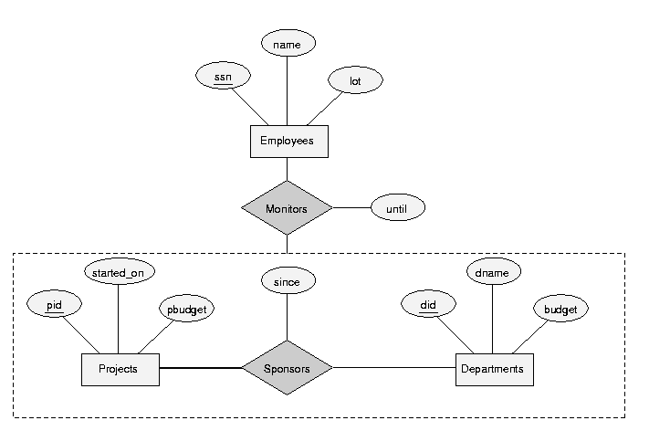
E-R Diagram With Aggregation
Defines a new relationship which associates some entity with some other existing relationship called aggregation.

Slide 46
Reduction to Relation Schemas
An E-R diagram can be represented by a collection of schemas.
Primary keys allow entity sets and relationship sets to be expressed uniformly as relation schemas.
For each entity set and relationship set there is a unique schema that is assigned the name of the corresponding entity set or relationship set.
Each schema has a number of columns (generally corresponding to attributes), which have unique names.

Slide 47

Representing Entity Sets as Schemas
A strong entity set reduces to a schema with the same attributes.
A weak entity set becomes a table that includes a column for the primary key of the identifying strong entity set
loan(loan_number, amount)
payment = ( loan_number, payment_number, payment_date, payment_amount )

Slide 48

Representing Relationship Sets as Schemas
A many-to-many relationship set is represented as a schema with attributes for the primary keys of the two participating entity sets, and any descriptive attributes of the relationship set.
Example: schema for relationship set borrower
borrower = (customer_id, loan_number )

Slide 49
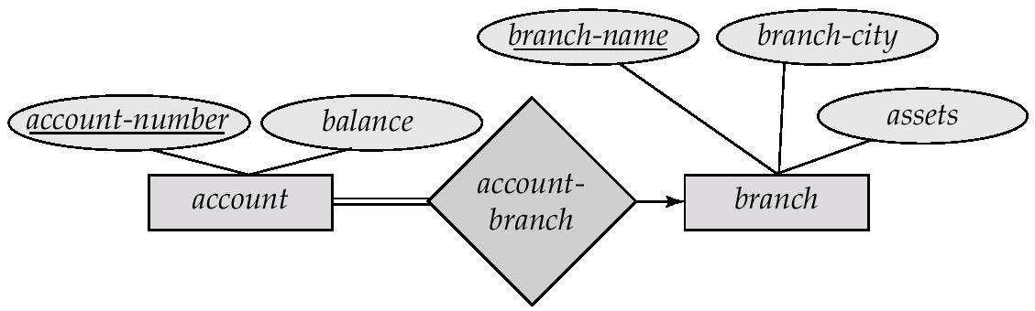
Redundancy of Schemas
Many-to-one and one-to-many relationship sets that are total on the many-side can be represented by adding an extra attribute to the “many” side, containing the primary key of the “one” side
Example: Instead of creating a schema for relationship set account_branch, add an attribute branch_name to the schema arising from entity set account
Account=(account-number, balance, branch-name)

Slide 50
Redundancy of Schemas (Cont.)
For one-to-one relationship sets, either side can be chosen to act as the “many” side
That is, extra attribute can be added to either of the tables corresponding to the two entity sets
If participation is partial on the “many” side, replacing a schema by an extra attribute in the schema corresponding to the “many” side could result in null values

Slide 51
Binary Vs. Non-Binary Relationships
Some relationships that appear to be non-binary may be better represented using binary relationships
E.g. A ternary relationship parents, relating a child to his/her father and mother, is best replaced by two binary relationships, father and mother
Using two binary relationships allows partial information (e.g. only mother being know)
But there are some relationships that are naturally non-binary
Example: works_on

Slide 52
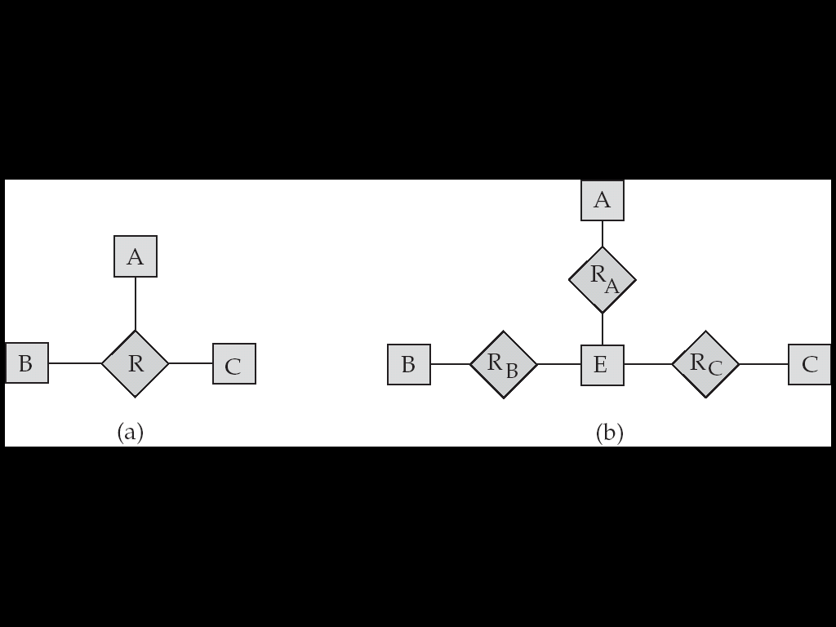
Converting Non-Binary Relationships to Binary Form
In general, any non-binary relationship can be represented using binary relationships by creating an artificial entity set.
Replace R between entity sets A, B and C by an entity set E, and three relationship sets:
1. R_{A}, relating E and A 2.R_{B}, relating E and B
3. R_{C}, relating E and C
Create a special identifying attribute for E
Add any attributes of R to E
For each relationship (a_{i} , b_{i} , c_{i}) in R, create
1. a new entity e_{i} in the entity set E 2. add (e_{i} , a_{i} ) to R_{A}
3. add (e_{i} , b_{i} ) to R_{B} 4. add (e_{i} , c_{i} ) to R_{C}

Slide 53
Binary vs. Ternary Relationships
name
ssn
lot
pname
age
Employees
Covers
Dependents
Bad design
Policies
policyid
cost
name
pname
age
ssn
lot
Dependents
Employees
Purchaser
Beneficiary
Better design
Policies
policyid
cost
Notes:
7

Slide 54
Transforming E-R Diagrams into Relations
To transform the conceptual data model into a set of normalized relations
Steps
Represent entities
Represent relationships
Normalize the relations
Merge the relations

Slide 55
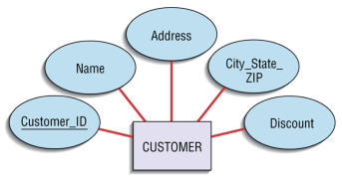

Transforming E-R Diagrams into Relations
Customer(Customer_ID, name, Address, City_State_ZIP, Discount)

Slide 56
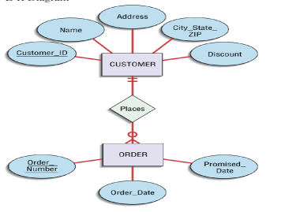
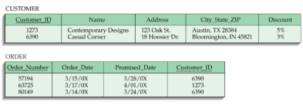
Transforming E-R Diagrams into Relations
Represent Relationships
Binary 1:N Relationships
Add the primary key attribute of the entity on the one side of the relationship as a foreign key in the relation on the many side

Slide 57
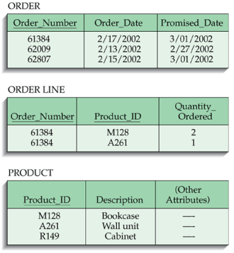
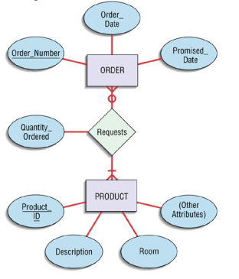
Transforming E-R Diagrams into Relations

Slide 58
Transforming E-R Diagrams into Relations
Binary 1:1 relationship
Three possible options
Add the primary key of A as a foreign key of B
Add the primary key of B as a foreign key of A
Both

Slide 59
Transforming E-R Diagrams into Relations
Represent Relationships (continued)
Binary and higher M:N relationships
Create another relation and include primary keys of all relations as primary key of new relation

Slide 60
Key Constraints
Each dept has at most one manager, according to the key constraint on Manages.
since
name
dname
ssn
lot
did
budget
CREATE TABLE Manages(
ssn CHAR(11),
did INTEGER,
since DATE,
PRIMARY KEY (did),
FOREIGN KEY (ssn) REFERENCES Employees,
FOREIGN KEY (did) REFERENCES Departments)
Employees
Manages
Departments
CREATE TABLE Dept_Mgr(
did INTEGER,
dname CHAR(20),
budget REAL,
ssn CHAR(11),
since DATE,
PRIMARY KEY (did),
FOREIGN KEY (ssn) REFERENCES Employees)
You can create single table for the relatin or no new table for relation but
Primary key foreign key relation
Only.
Notes:
6

Slide 61
Weak Entities
Weak entity set and identifying relationship set are translated into a single table.
When the owner entity is deleted, all owned weak entities must also be deleted.
name
ssn
lot
cost
pname
age
Employees
Policy
Dependents
CREATE TABLE Dep_Policy (
pname CHAR(20),
age INTEGER,
cost REAL,
ssn CHAR(11) NOT NULL,
PRIMARY KEY (pname, ssn),
FOREIGN KEY (ssn) REFERENCES Employees, ON DELETE CASCADE
)
Notes:
10

Slide 62
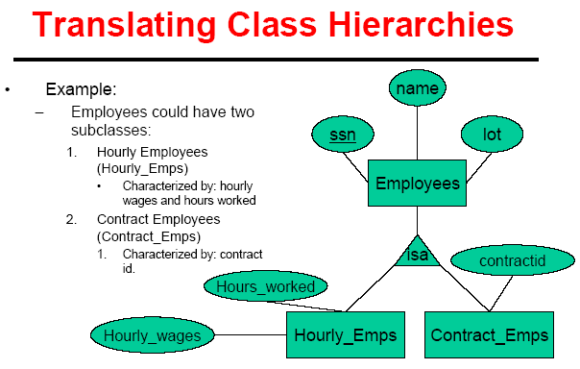
Translating hierarchies
Two approaches
Three tables: employee, contract_emps,Hourly_emps
Two tables: Employees having Contract_emps attributes and Hourly_emps. And vice versa
Notes:
15

Slide 63
Thank You

